Slide 1

AMAZON SALES ANALYSIS
- SHAKEEB QURESHI
- AVASH KUMAR PANDA

Slide 2
CONTENTS
1 - Introduction 2 – Problem Statement 3 – Key Performance Indicators 4 - Country, Region & Item Type Wise Revenue 5 - Ship Duration, Region & Order Priority Wise Unit Sold 6 – Item Type, Region & Country Wise Profit 7 - Month & Sales Channel Wise Profit - Revenue

Slide 3
INTRODUCTION
An in-depth examination of Amazon's sales data highlights important metrics and influencing factors. This analysis reveals significant connections between attributes such as Year, Month, Sales Channel, Order Priority, and Region, and metrics like Sales, Profit, Cost, and Order Distribution.

Slide 4
PROBLEM STATEMENT
Sales management has gained importance to meet increasing competition and the need for improved methods of distribution to reduce cost and to increase profits. Sales management today is the most important function in a commercial and business enterprise.

Slide 5




Key Performance Indicators

Slide 6
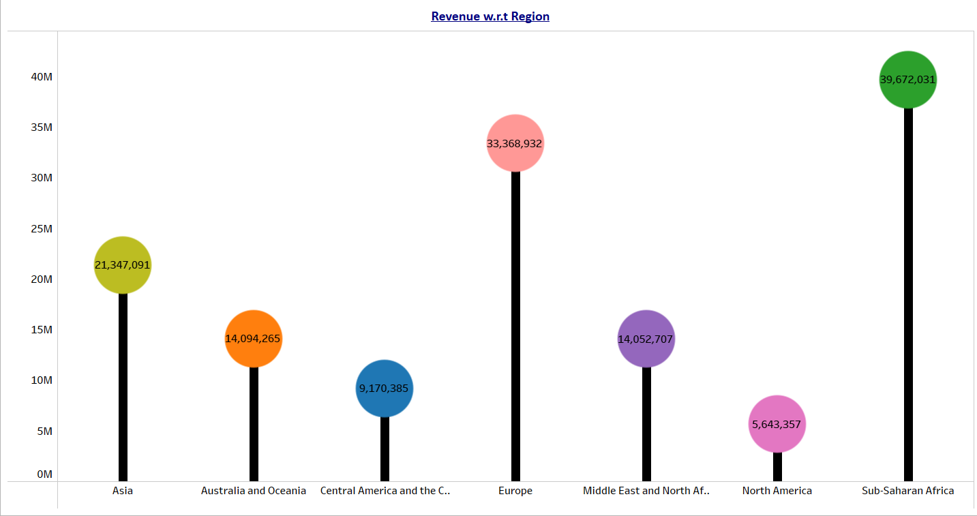
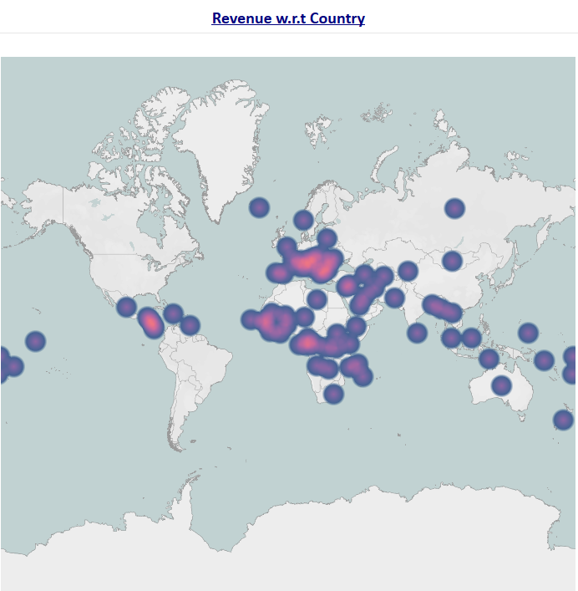
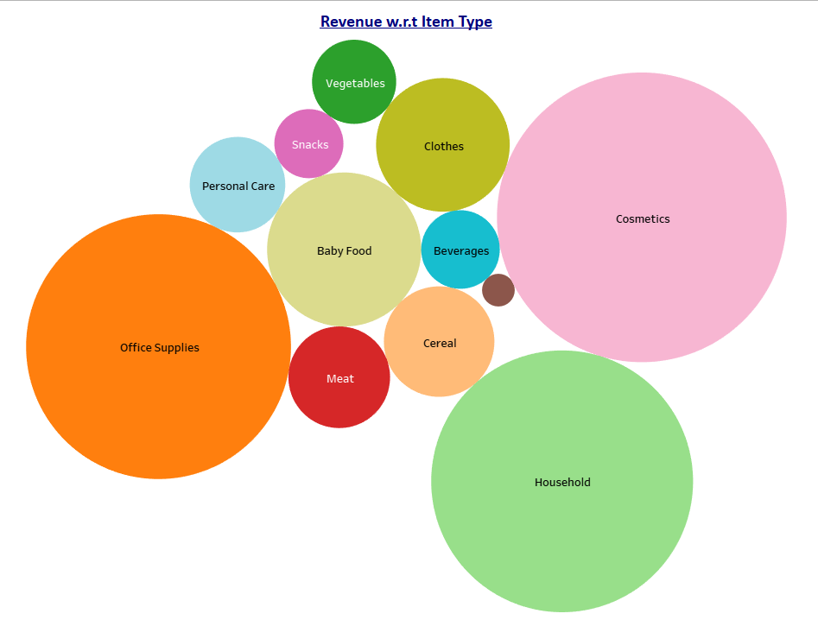
Country, Region & Item Type Wise Revenue

Slide 7
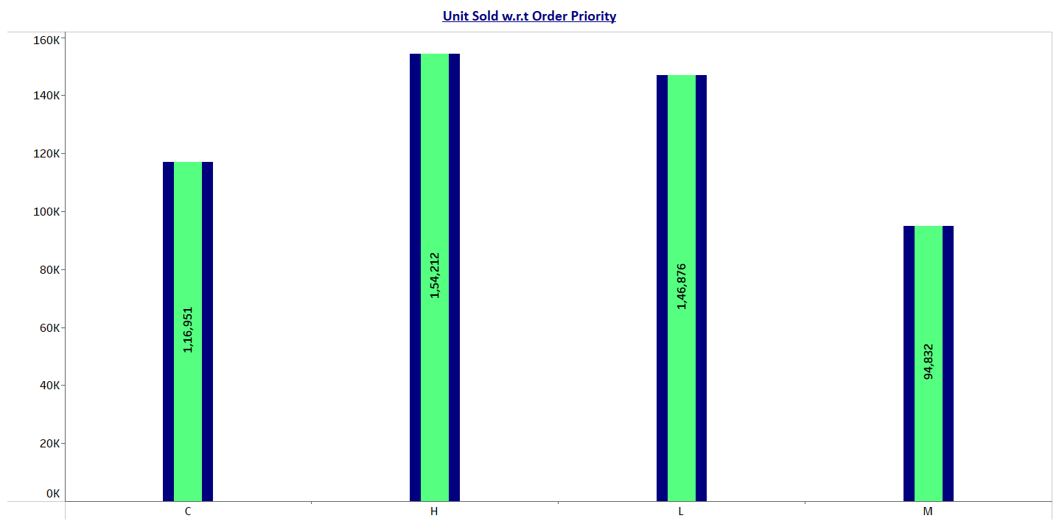
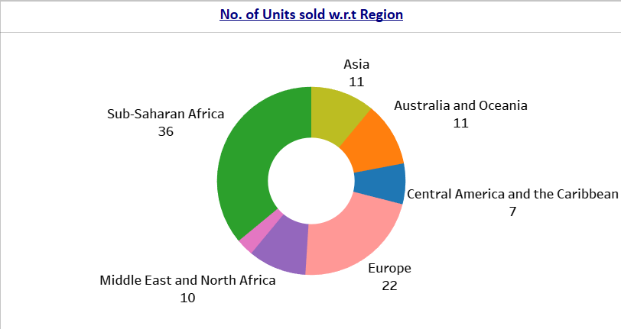
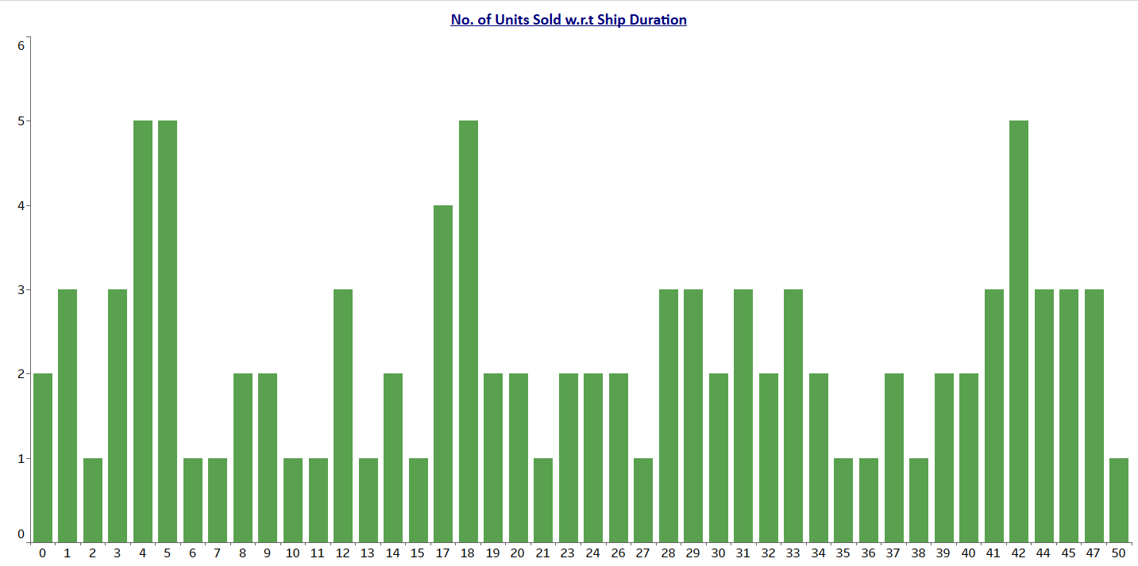
Ship Duration, Region & Order Priority Wise Unit Sold

Slide 8
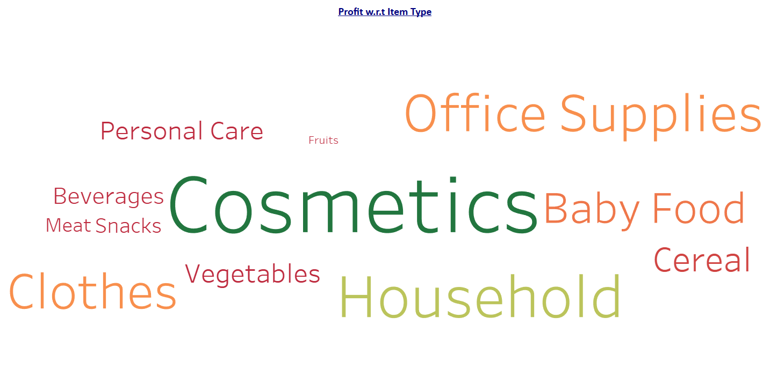
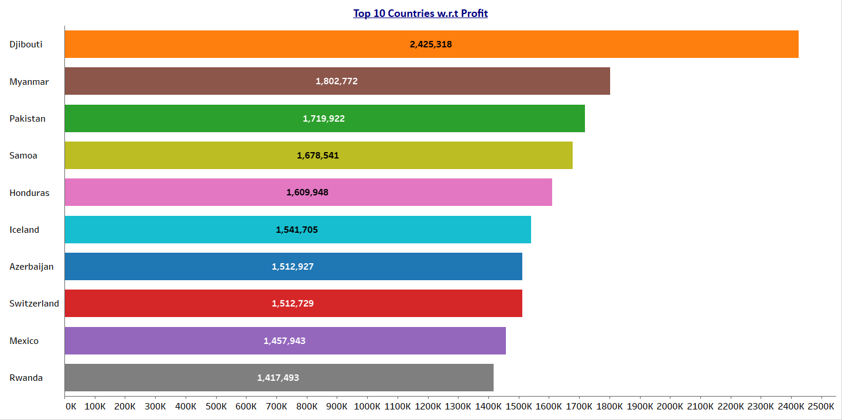
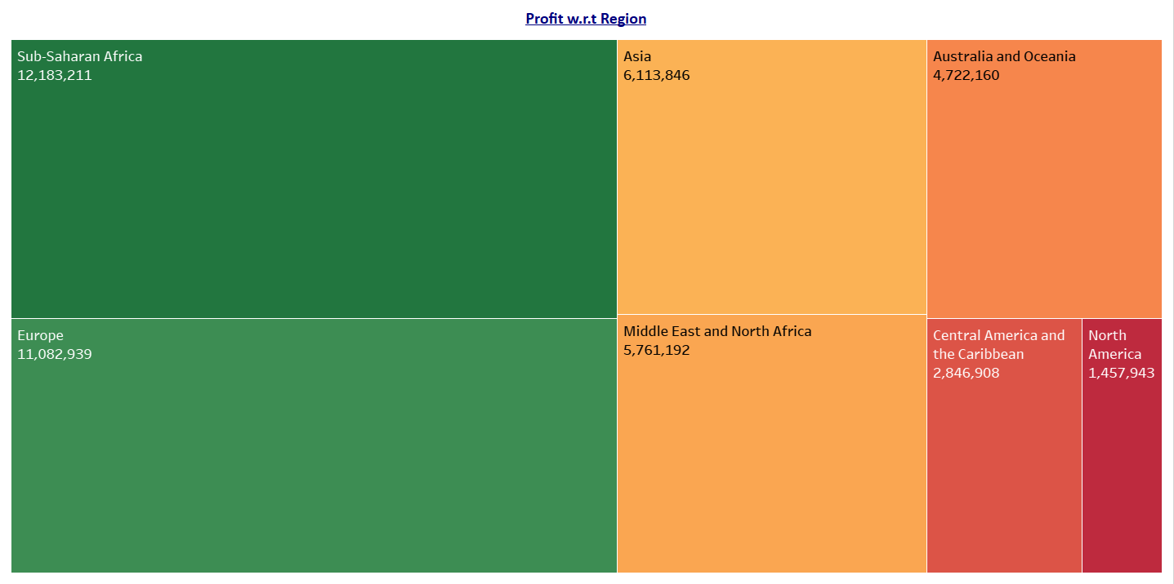
Item Type, Region & Country Wise Profit

Slide 9
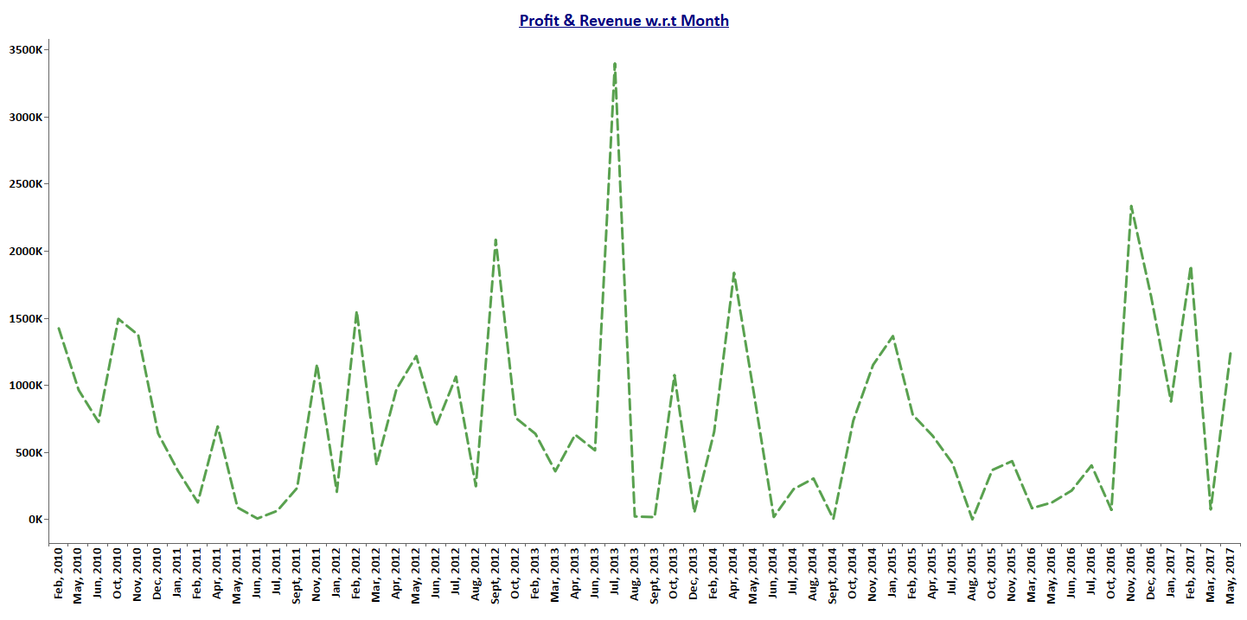
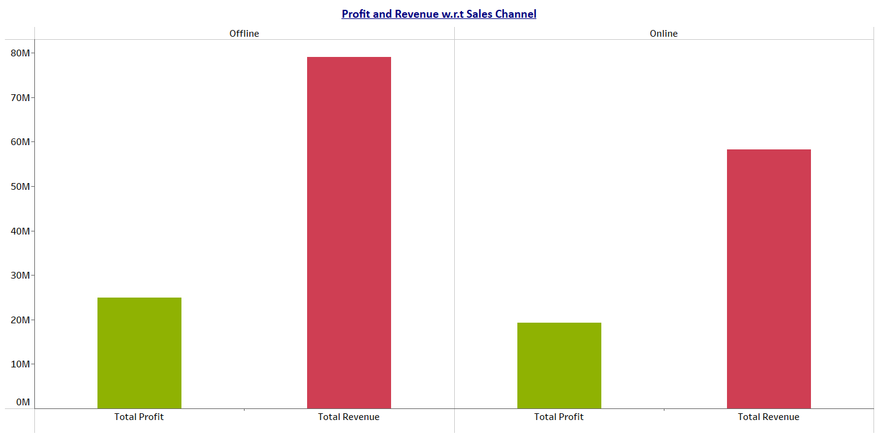
Month & Sales Channel Wise Profit - Revenue

Slide 10
THANK YOU
- SHAKEEB QURESHI

